Slide 1
Lab 5 Seven Segment Decoder
EcEn 220

Slide 2
Taming Vivado
Under Resources
Multiple copies of Vivado running from other user
Power cycle your entire machine

Slide 3
Moving Forward
At this point in the semester, we are getting familiar with
Vivado
Tcl file
Testbench
SystemVerilog Coding Standard
Structural SystemVerilog
For the rest of the semester, we will focus on circuit design
Dataflow
Behavioral
If your circuit doesn’t work, it is most likely because your design is wrong.
Do not expect the TAs to help debugging your design.

Slide 4
a
b
c
d
e
f
g
1
1
1
1
1
1
1
1
1
1
1
1
1
1
a
f
b
g
e
c
d

Slide 5
a
b
c
d
e
f
g
1
0
1
1
1
1
1
1
1
1
1
1
1
1
a
f
b
g
e
c
d

Slide 6
a
b
c
d
e
f
g
1
1
1
0
1
1
1
1
1
1
1
1
1
1
a
f
b
g
e
c
d

Slide 7
a
b
c
d
e
f
g
1
1
1
1
1
0
1
1
1
1
1
1
1
1
a
f
b
g
e
c
d

Slide 8
a
b
c
d
e
f
g
1
1
1
1
1
1
1
0
1
1
1
1
1
1
a
f
b
g
e
c
d

Slide 9
a
b
c
d
e
f
g
1
1
1
1
1
1
1
1
1
0
1
1
1
1
a
f
b
g
e
c
d

Slide 10
a
b
c
d
e
f
g
1
1
1
1
1
1
1
1
1
1
1
0
1
1
a
f
b
g
e
c
d

Slide 11
a
b
c
d
e
f
g
1
1
1
1
1
1
1
1
1
1
1
1
1
0
a
f
b
g
e
c
d

Slide 12
a
f
b
g
e
c
d

Slide 13
a
f
b
g
e
c
d

Slide 14
a
f
b
g
e
c
d

Slide 15
a
f
b
g
e
c
d

Slide 16
a
f
b
g
e
c
d

Slide 17
a
f
b
g
e
c
d

Slide 18
a
f
b
g
e
c
d

Slide 19
a
f
b
g
e
c
d

Slide 20
a
f
b
g
e
c
d

Slide 21
a
f
b
g
e
c
d

Slide 22
a
f
b
g
e
c
d

Slide 23
a
f
b
g
e
c
d

Slide 24
a
f
b
g
e
c
d

Slide 25
a
f
b
g
e
c
d

Slide 26
a
f
b
g
e
c
d

Slide 27
a
f
b
g
e
c
d

Slide 28
a
f
b
g
e
c
d

Slide 29
Design Process
Block Diagram, specify Inputs/Outputs
Complete a Truth Table
Determine output logic equations
Instance LUT’s
Simulate
Synthesis/Download
Test on the Board

Slide 30
Seven Segment Decoder
CA – segment[0]
CB – segment[1]
data[0]
Combinational
Logic
data[1]
CC – segment[2]
data[2]
CD – segment[3]
data[3]
CE – segment[4]
CF – segment[5]
CG – segment[6]

Slide 31
16’h 1083 16’h 208E 16’h 02BA
16’h 8492
16’h D004
16’h D860
16’h 2812
Hex | Input |  |  |  | Output
Character | Binary |  |  |  | Segment [6:0]
0 | data[3] | data[2] | data[1] | data[0] | CG | CF | CE | CD | CC | CB | CA
0 | 0 | 0 | 0 | 0 | 1 | 0 | 0 | 0 | 0 | 0 | 0
1 | 0 | 0 | 0 | 1 | 1 | 1 | 1 | 1 | 0 | 0 | 1
2 | 0 | 0 | 1 | 0 | 0 | 1 | 0 | 0 | 1 | 0 | 0
3 | 0 | 0 | 1 | 1 | 0 | 1 | 1 | 0 | 0 | 0 | 0
4 | 0 | 1 | 0 | 0 | 0 | 0 | 1 | 1 | 0 | 0 | 1
5 | 0 | 1 | 0 | 1 | 0 | 0 | 1 | 0 | 0 | 1 | 0
6 | 0 | 1 | 1 | 0 | 0 | 0 | 0 | 0 | 0 | 1 | 0
7 | 0 | 1 | 1 | 1 | 1 | 1 | 1 | 1 | 0 | 0 | 0
8 | 1 | 0 | 0 | 0 | 0 | 0 | 0 | 0 | 0 | 0 | 0
9 | 1 | 0 | 0 | 1 | 0 | 0 | 1 | 0 | 0 | 0 | 0
A | 1 | 0 | 1 | 0 | 0 | 0 | 0 | 1 | 0 | 0 | 0
b | 1 | 0 | 1 | 1 | 0 | 0 | 0 | 0 | 0 | 1 | 1
C | 1 | 1 | 0 | 0 | 1 | 0 | 0 | 0 | 1 | 1 | 0
d | 1 | 1 | 0 | 1 | 0 | 1 | 0 | 0 | 0 | 0 | 1
E | 1 | 1 | 1 | 0 | 0 | 0 | 0 | 0 | 1 | 1 | 0
F | 1 | 1 | 1 | 1 | 0 | 0 | 0 | 1 | 1 | 1 | 0
a
f
b
g
e
c
d

Slide 32
Hex | Input |  |  |  | Output
Character | Binary |  |  |  | Segment [6:0]
0 | data[3] | data[2] | data[1] | data[0] | CG | CF | CE | CD | CC | CB | CA
0 | 0 | 0 | 0 | 0
1 | 0 | 0 | 0 | 1
2 | 0 | 0 | 1 | 0
3 | 0 | 0 | 1 | 1
4 | 0 | 1 | 0 | 0
5 | 0 | 1 | 0 | 1
6 | 0 | 1 | 1 | 0
7 | 0 | 1 | 1 | 1
8 | 1 | 0 | 0 | 0
9 | 1 | 0 | 0 | 1
A | 1 | 0 | 1 | 0
b | 1 | 0 | 1 | 1
C | 1 | 1 | 0 | 0
d | 1 | 1 | 0 | 1
E | 1 | 1 | 1 | 0
F | 1 | 1 | 1 | 1
a
f
b
g
e
c
d

Slide 33
How to choose which digit to display?
There are 4 digits.
A logic value of 0 must be passed to the anode to turn on a digit.
Turn on all 4 digits
assign anode = 4’b0000;
Turn off all 4 digits
assign anode = 4’b1111;

Slide 34
How to turn on the digit point?
Digit point is turned on if the 8th segment (segment[7]) or DP is set to 0.
We will use (press) the center button (btnc) to turn on the digit point.

Slide 35
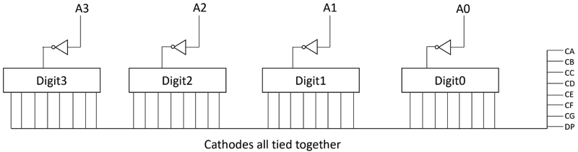
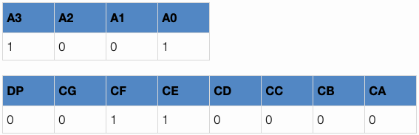


Slide 36
module seven_segment_top(
input wire logic [3:0] data,
output logic [6:0] segment,
);
endmodule
Structural SV (gates like in Lab 3), in non-minimized, sum-of-products form.
Structural SV, minimized using the theorems in Table 4.1 of the textbook.
Dataflow SV, using an assign statement and the ?: (sometimes called the ternary) operator.
Dataflow SV, using an assign statement and dataflow operators of your choice (comparison, and, or, etc.).
Be very careful using internal signals. Make sure the connection is correct.
No signal can be used as output more than once. Signals can be used as input multiple times.

Slide 37
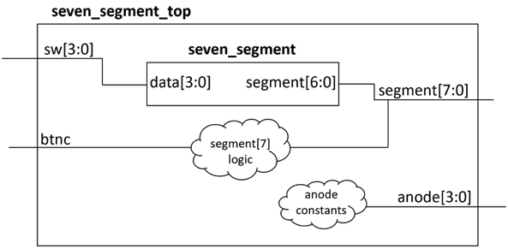
Top-Level
module seven_segment_top(
input wire logic [3:0] sw,
input wire logic btnc,
output logic [7:0] segment,
output logic [3:0] anode
);
endmodule
Turn on the digit point when btnc is pressed.
Design this circuit
Turn on the right most digit.
Set the correct anode signal.
Be very careful matching the width of signals.

Slide 38
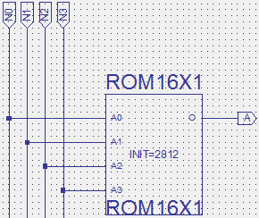
Rom Logic
N3 | N2 | N1 | N0 | a
0 | 0 | 0 | 0 | 0
0 | 0 | 0 | 1 | 1
0 | 0 | 1 | 0 | 0
0 | 0 | 1 | 1 | 0
0 | 1 | 0 | 0 | 1
0 | 1 | 0 | 1 | 0
0 | 1 | 1 | 0 | 0
0 | 1 | 1 | 1 | 0
1 | 0 | 0 | 0 | 0
1 | 0 | 0 | 1 | 0
1 | 0 | 1 | 0 | 0
1 | 0 | 1 | 1 | 1
1 | 1 | 0 | 0 | 0
1 | 1 | 0 | 1 | 1
1 | 1 | 1 | 0 | 0
1 | 1 | 1 | 1 | 0
Works like a 16 to 1 multiplexer. The “inputs” are constant, according to the INIT string
0010 1000 0001 0010

Slide 39
Hierarchy
CC
N0
ROM
Logic
CD
N1
CE
N2
CF
N3
CG
Combinational
Logic
CA
CB
Seven Segment Decoder

